Slide 1

B.M.S. College of
Engineering
Full-Stack Web Development – External Lab Exam
23DC3AEFWD
WEBPAGE FOR SAFFRON SPICE RESTAURANT
R V ABHISHEK (1BM23CD067)
SUSHANTH S (1BM23CD063)
ULLAS N (1BM23CD067)
LAVANYA NAIK
Assistant Professor
Department of CSE(Data Science)
BMSCE, Bengaluru

Slide 2

B.M.S. College of
Engineering
Table of Contents
INTRODUCTION
PROBLEM STATEMENT
SOFTWARE & HARDWARE REQUIREMENTS
ER DIAGRAM
DEMONSTRATION
FUTURE ENHANCEMENT
Department of Computer Science Engineering(Data Science)

Slide 3
Introduction about the project
B.M.S. College of
Engineering
Project Overview:
The Saffron Spice Website is a comprehensive web application designed to streamline the process of making restaurant reservations and managing customer orders.
Architecture Overview: Project Structure:
Frontend (React.js)
- src/components: Reusable components like Cart, ReservationForm
- src/pages: Page components like HomePage, LoginPage
- src/assets: Images and static assets
Backend (Node.js)
- models: Mongoose models for User, Reservation, Car t
- routes: Express routes for APIs
- middleware: Authentication and other middleware
- utils: Utility functions like checkAvailableSlots
Department of Computer Science Engineering(Data Science)

Slide 4
Introduction about the project
B.M.S. College of
Engineering
Key Features:
- User Authentication:
Secure login and registration system for users.
- Reservation Management:
Book tables, select time slots, and specify guests.
- Cart Management:
Add menu items to the cart, view details, and update quantities.
- Integrated Reservation and Cart:
Cart items are stored with reservations
Department of Computer Science Engineering(Data Science)

Slide 5
B.M.S. College of
Engineering
Problem Statement
Restaurant reservation systems are often fragmented and lack seamless integration with order management, leading to inefficiencies for both users and restaurant staff.
Key Issues:
Difficulty in managing table reservations during peak hours.
Lack of real-time updates on table availability.
Inefficient cart and order handling processes.
Impact:
Reduced customer satisfaction.
Increased operational errors.
Missed opportunities for restaurants to optimize services.
Why This Project is Needed: The Saffron Spice Website bridges these gaps by providing an integrated solution that streamlines reservations, ensures data consistency, and enhances user experience.
Department of Computer Science Engineering(Data Science)

Slide 6
B.M.S. College of
Engineering
Software & Hardware Requirements
Software Requirements:
Development Environment:
- Visual Studio Code (Latest Version)
- Node.js (v14.0.0 or higher)
- npm (v6.0.0 or higher)
Frontend Dependencies:
{
"dependencies": {
"express": "^4.17.1",
"mongoose": "^6.0.0",
"dotenv": "^10.0.0"
}}
Backend Dependencies:
{
"dependencies": {
"express": "^4.17.1",
"mongoose": "^6.0.0",
"dotenv": "^10.0.0"
}}
Department of Computer Science Engineering(Data Science)

Slide 7
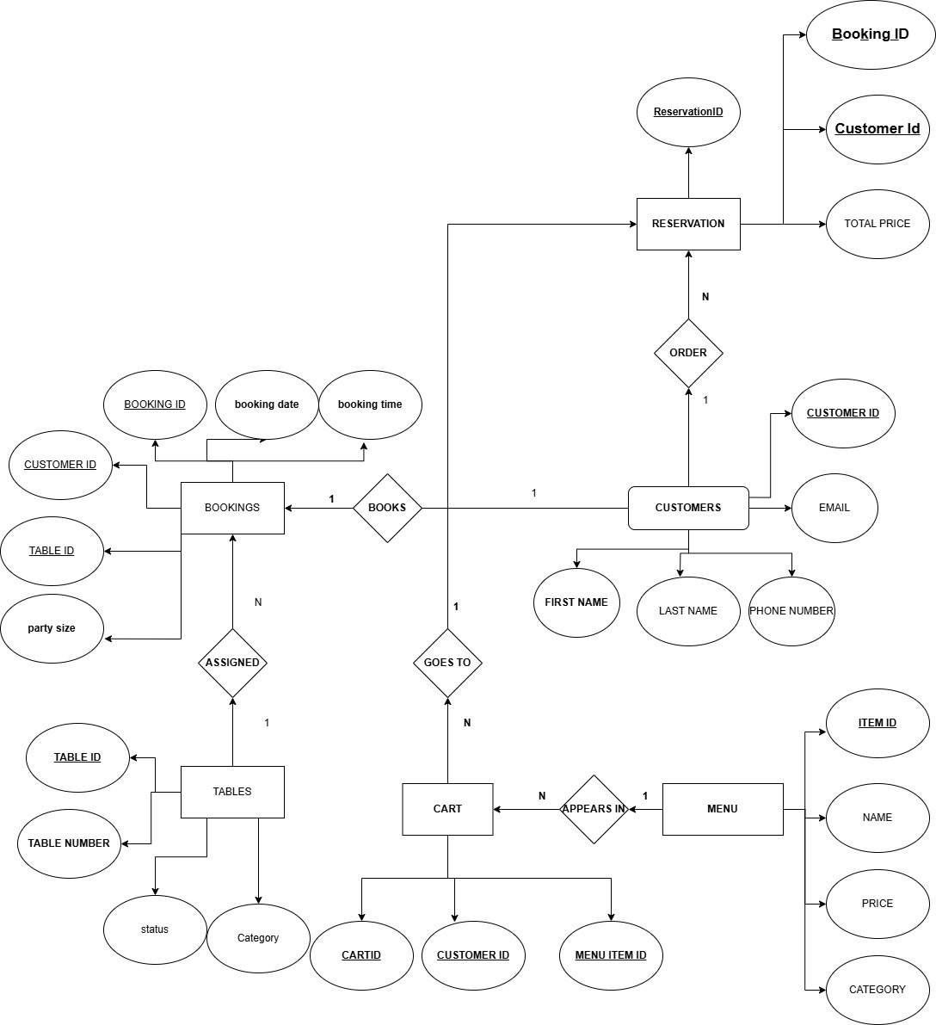
B.M.S. College of
Engineering
ER Diagram
Fig.4 ER DIAGRAM
Department of Computer Science Engineering(Data Science)

Slide 8
// Key Features from ReservationForm.js
- Guest count validation
- Date selection (with max date limit)
- Time slot selection
- Table type selection
- Multiple table booking
- Confirmation popup
B.M.S. College of
Engineering
Demonstration
User Flow:
Homepage to Reservation
Navigation: Steps from the homepage to the reservation page.
Initial Guest Count Selection: Interface for entering the number of guests.
Date Selection Interface: Calendar for choosing a reservation date.
2. Reservation Form Features
- Guest count validation
- Date selection (with max date limit)
- Time slot selection
- Table type selection
- Multiple table booking
- Confirmation popup
Department of Computer Science Engineering(Data Science)

Slide 9
const formatTimeSlot = (time) => {
const [hours] = time.split(':');
const hour = parseInt(hours);
return `${hour > 12 ? hour - 12 : hour}:00 ${hour >= 12 ? 'PM' : 'AM'}`;
};
B.M.S. College of
Engineering
Demonstration
Core Functionalities:
Time Slot Formatting
State management
const filteredSlots = timeSlots.filter((slot) => {
const [hours, minutes] = slot.split(':').map(Number);
const slotTime = new Date(selectedDate);
slotTime.setHours(hours, minutes, 0, 0);
return slotTime >= minBookingTime;
});
- Guest Management
- Date Selection
- Time Slot Selection
- Table Type Selection
- Error Handling
Department of Computer Science Engineering(Data Science)

Slide 10
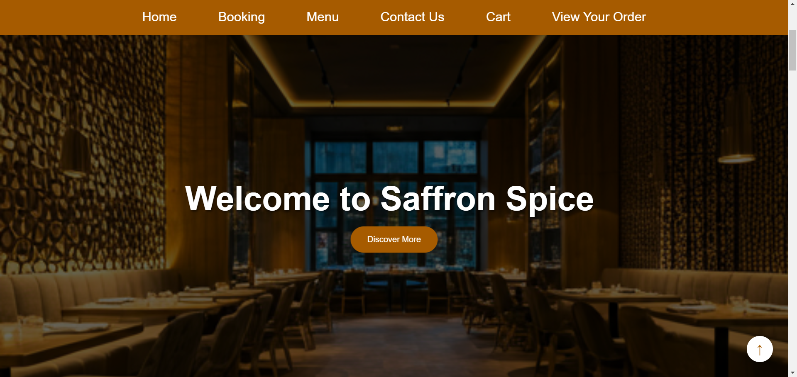
const formatTimeSlot = (time) => {
const [hours] = time.split(':');
const hour = parseInt(hours);
return `${hour > 12 ? hour - 12 : hour}:00 ${hour >= 12 ? 'PM' : 'AM'}`;
};
B.M.S. College of
Engineering
Demonstration
Key Screenshots: 1.Home Page
Fig 5.1 Home Page

Slide 11
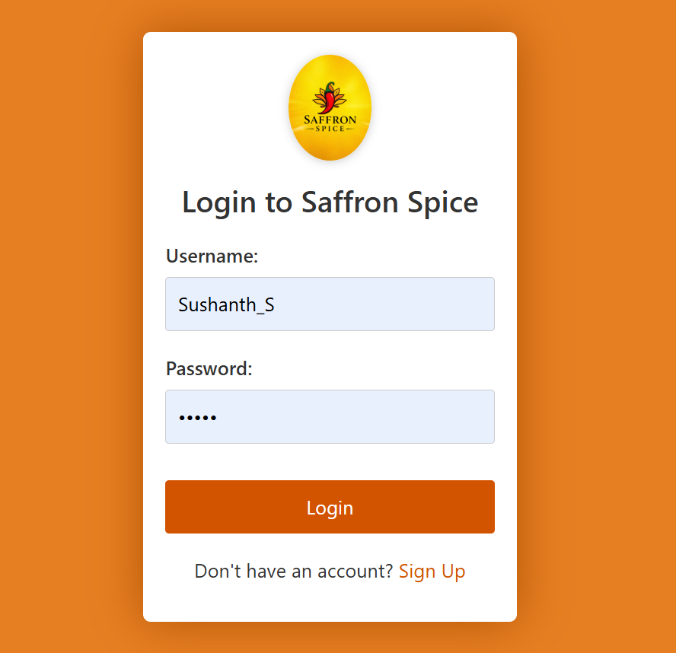
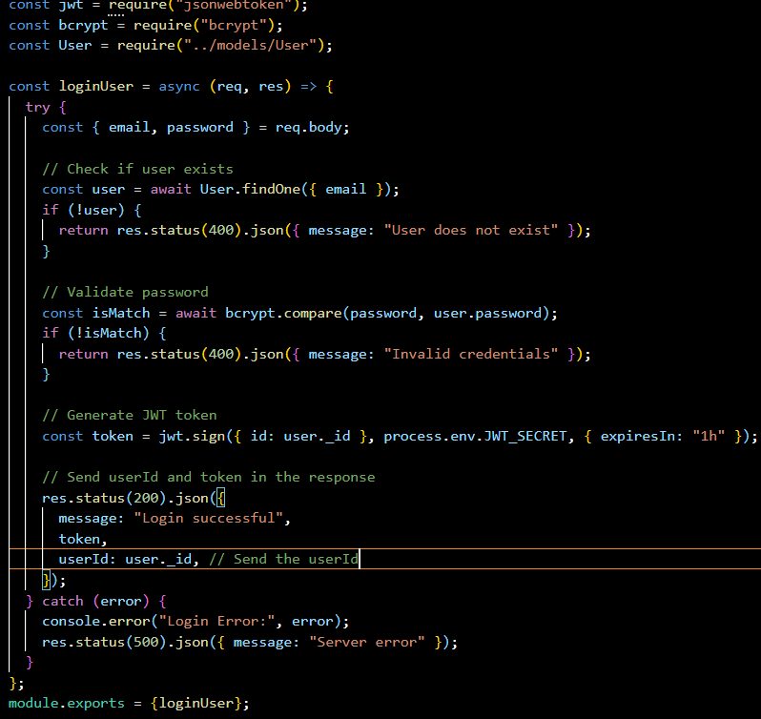
B.M.S. College of
Engineering
DEMONSTRATION
LOGIN PAGE:
Fig 5.2 Login Page
USER AUTHENTICATION PROGRAM​

Slide 12
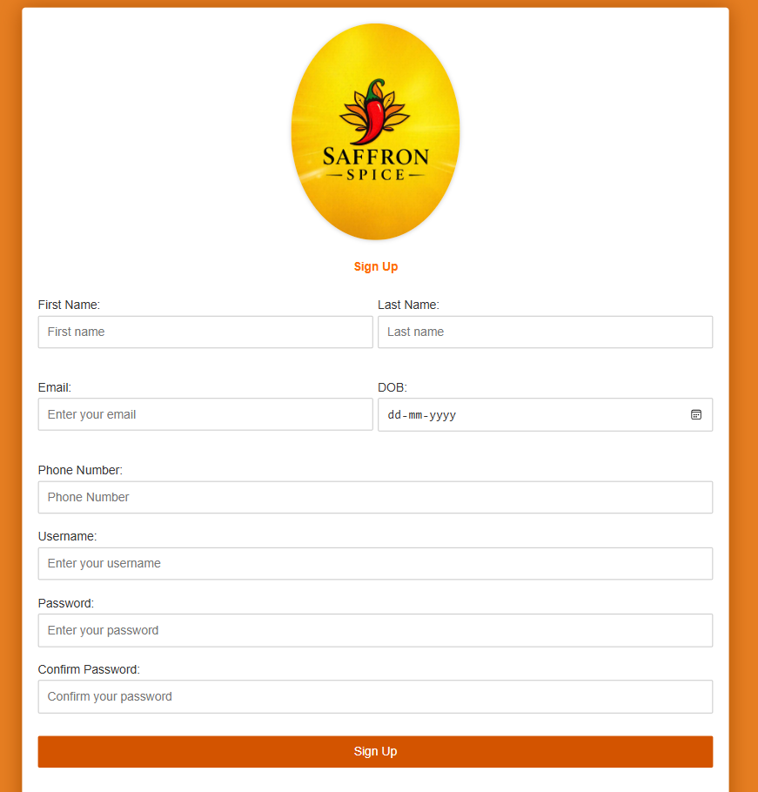
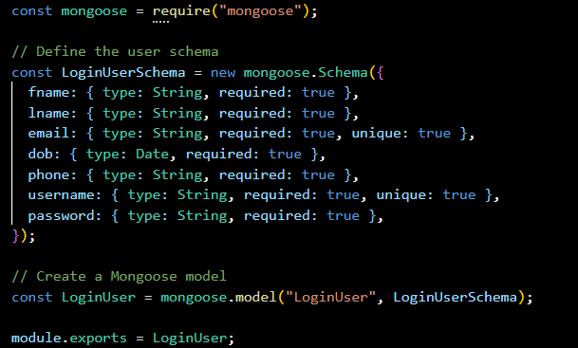
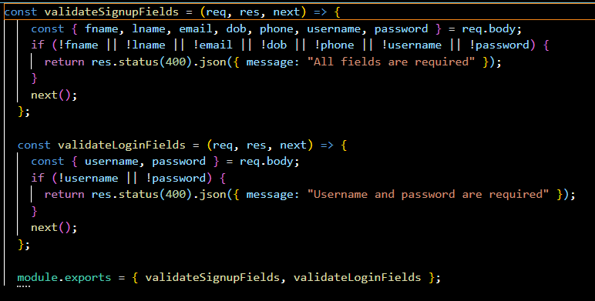
B.M.S. College of
Engineering
DEMONSTRATION
SIGN UP PAGE:
Fig 5.3 SignUp Page
SIGNUP SCHEMA AND INPUT VALIDATION​
Department of Computer Science Engineering(Data Science)

Slide 13
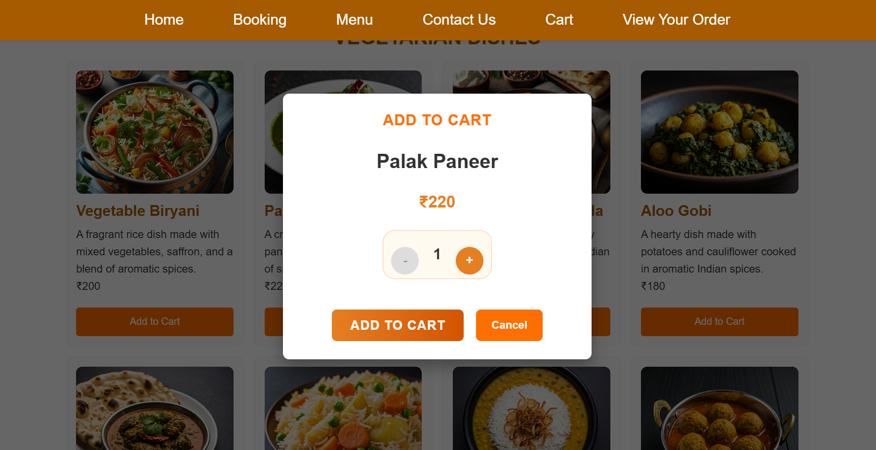
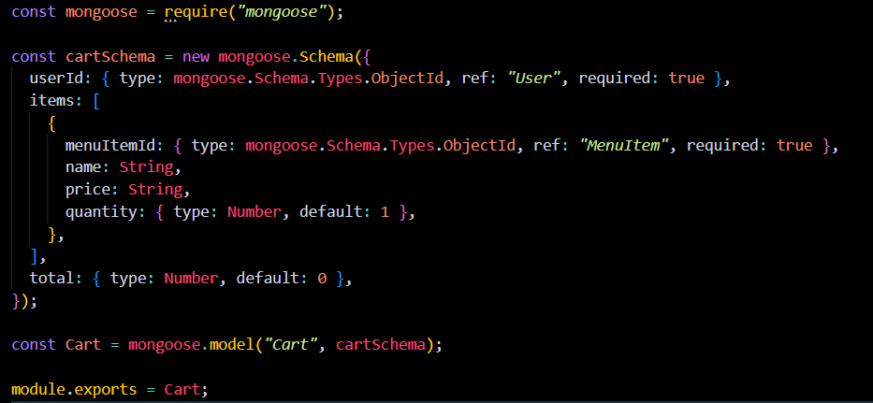
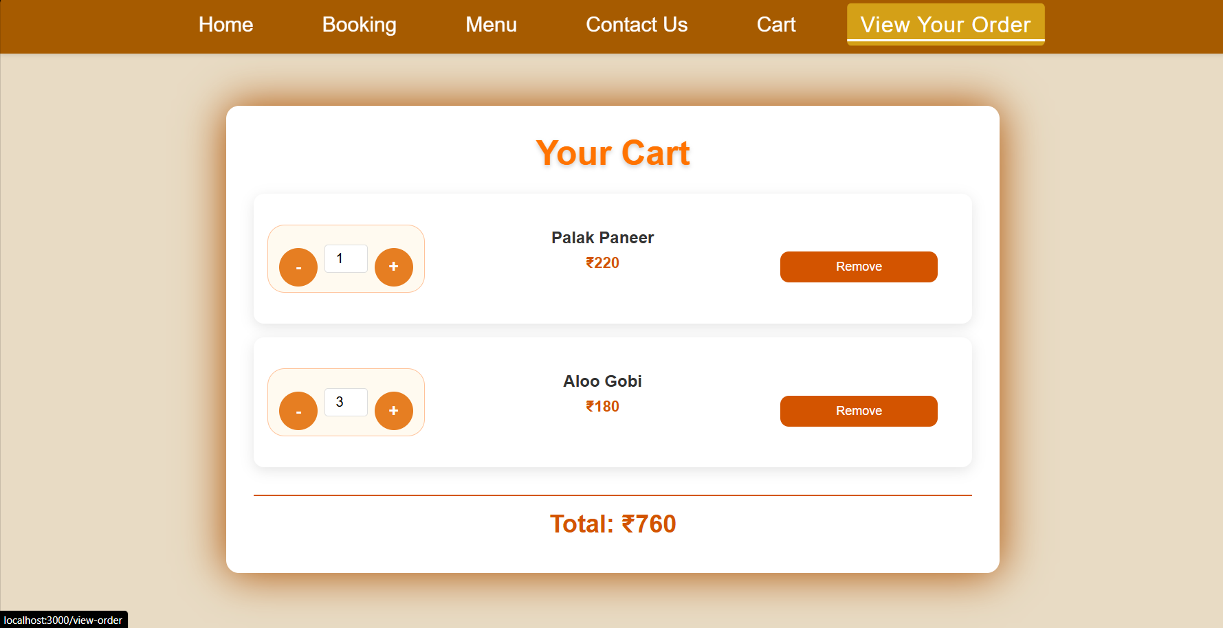
B.M.S. College of
Engineering
DEMONSTRATION
CART MODEL
Fig 5.4 Cart model
Department of Computer Science Engineering(Data Science)

Slide 14
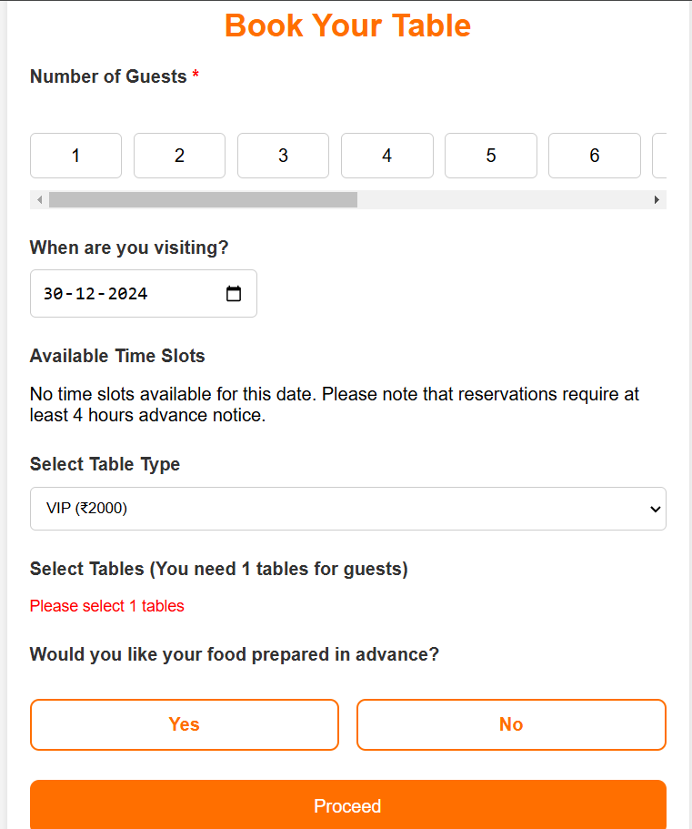
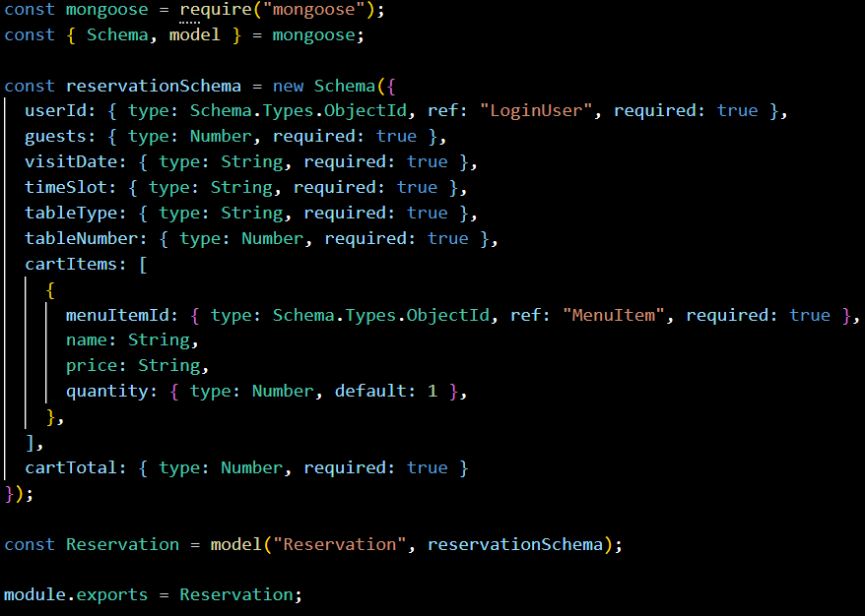
return `${hour > 12 ? hour - 12 : hour}:00 ${hour >= 12 ? 'PM' : 'AM'}`;
};
B.M.S. College of
Engineering
Demonstration
Reservation Form
Fig 5.5 Reservation Form
DATABASE SCHEMA FOR RESERVATION TABLE

Slide 15
B.M.S. College of
Engineering
Future Enhancements
Payment Integration
Enable secure online payment methods (credit/debit cards, digital wallets, etc.) for a seamless user experience.
Ensure PCI compliance and support multiple currencies.
Notifications
Implement automated email and SMS confirmations for bookings and orders.
Include reminders, promotional offers, and order status updates.
Functionality
Change the capacity of each table according to a real-world restaurant and cater to the number and organization of the tables according to the restaurant's needs.
Third-Party Sign-Up Integration
Integrate sign-up and login functionality using popular platforms such as:
Google
Facebook
Apple
Enhance user convenience, streamline registration processes, and improve security.
Department of Computer Science Engineering(Data Science)

Slide 16
B.M.S. College of
Engineering
THANK YOU
Department of Computer Science Engineering(Data Science)

